Slide 1
Matlab程式設計_3_16
助教:金郁善

Slide 2
Trigonometry
sin() | Sine of argument in radians
Sind() | Sine of argument in degrees
asin() | Inverse sine in radians
asind() | Inverse sine in degrees
cos() | Cosine of argument in radians
cosd() | Cosine of argument in degrees
acos() | Inverse cosine in radians
acosd() | Inverse cosine in degrees
tan() | tangent of argument in radians
tand() | tangent of argument in degrees
atan() | Inverse tangent in radians
atand() | Inverse tangent in degrees

Slide 3
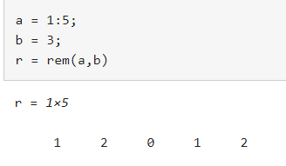
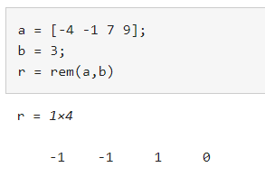
rem function
r = rem(a,b)
r= rem(a,b) returns the remainder after division of a by b, where a is the dividend and b is the divisor - rem(a,0) is NaN
-nonzero results have the same sign as the dividend

Slide 4
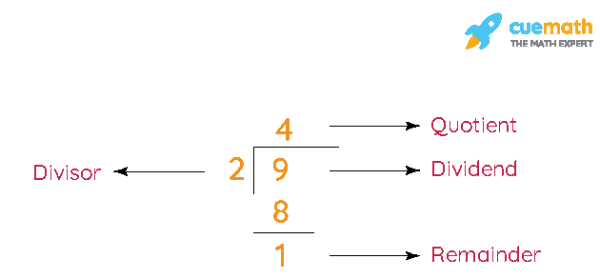

Slide 5
factorial function
f= factorial(n)
10! ➔ factorial(10)
Hypotenuse function
h= hypot(x,y)
Hypotenuse of x,y
H=hypot(A,B)
H=sqrt(abs(A).^2+abs(B).^2)

Slide 6
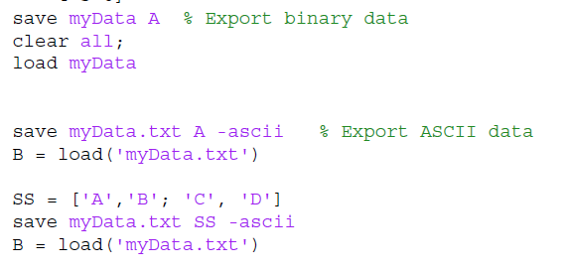
Save

Slide 7
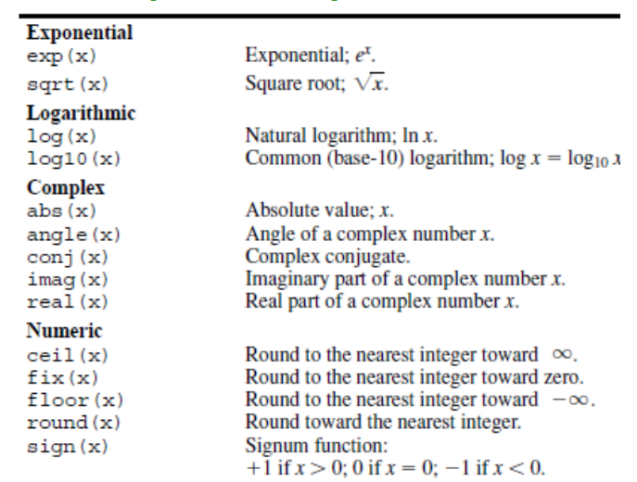
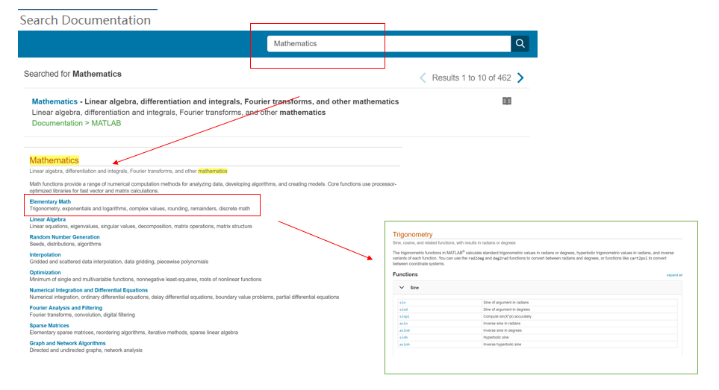
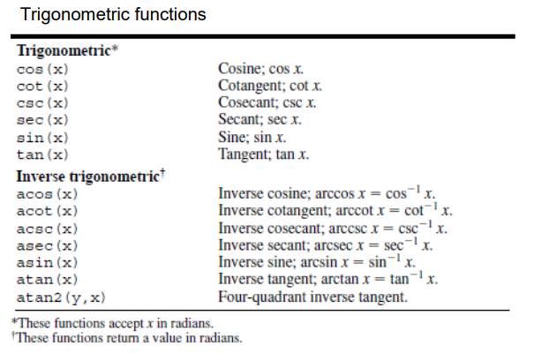
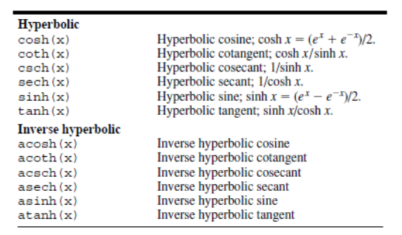
Matlab building function

Slide 8
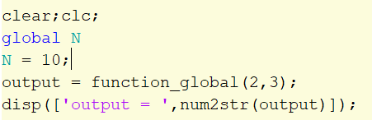
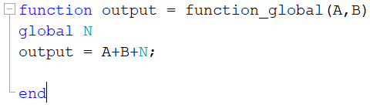
Function – global

Slide 9


Complex number
Z = X +i*Y;

Slide 10
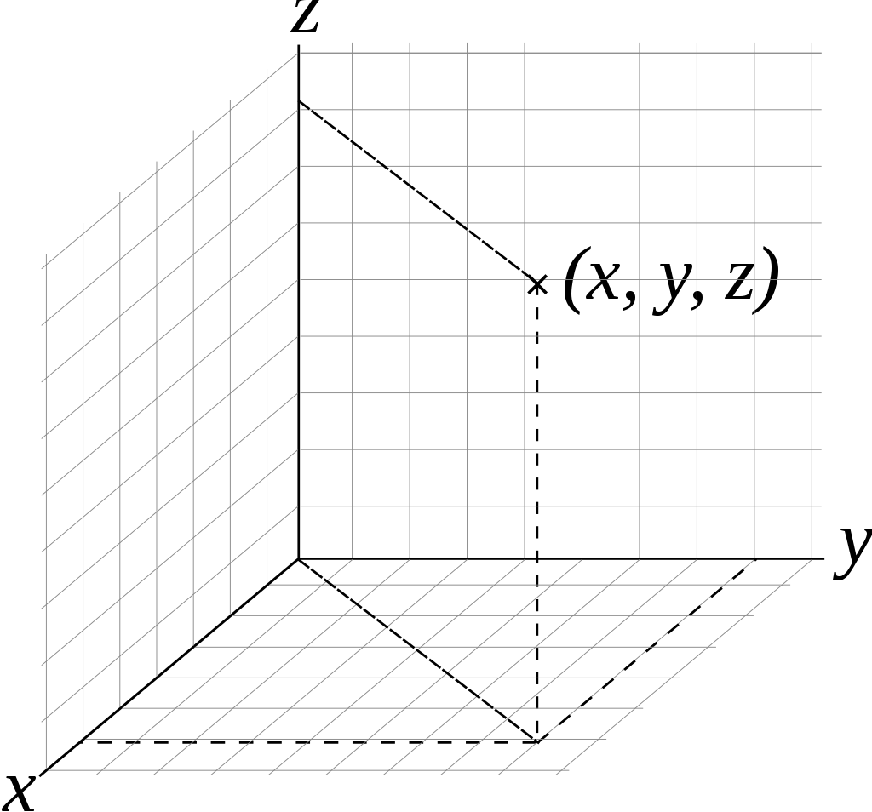
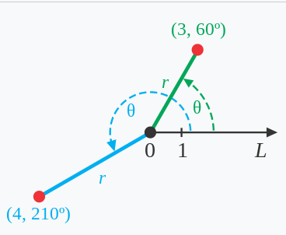
Cartesian coordinate
polar coordinate
z = x +i*y;
(cartesian) ->(polar)
Mag_z=Abs(z);
Ang_z=atan(y,x)*180/pi; %rad
(polar) ->(cartesian)
x2=mag_z.*cosd(ang_z);
y2=mag_z.*sind(ang_z);
% in radian
x2=abs(z).*cos(atan2(y,x));
y2=abs(z).*sin(atan2(y,x));

Slide 11
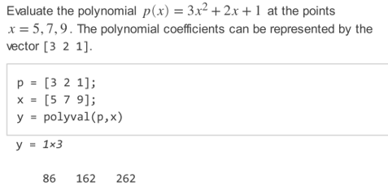
polyval

Slide 12



Polyint
Polyder
clear;clc;
p =[3 0 -4 10 -25];
q =polyint(p);
a = -1;b = 3;
I = diff(polyval(q,[a,b]));
clear;clc;
p =[3 0 -4 10 -25];
q =polyder(p);

Slide 13
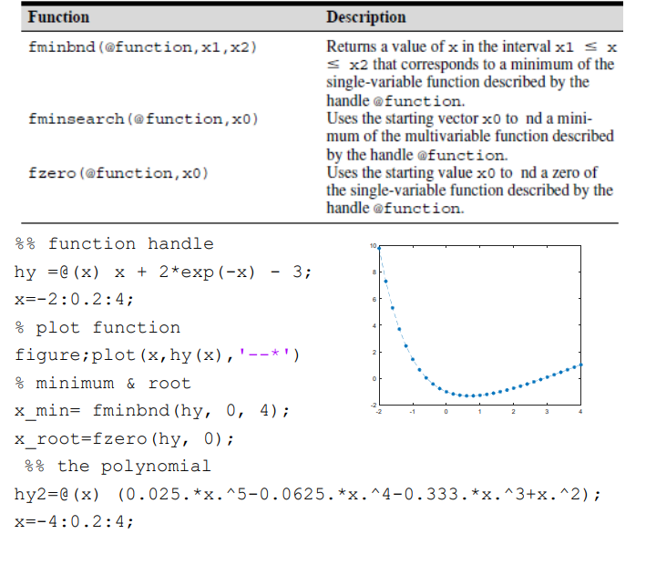

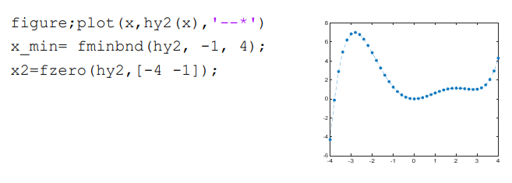


Slide 14
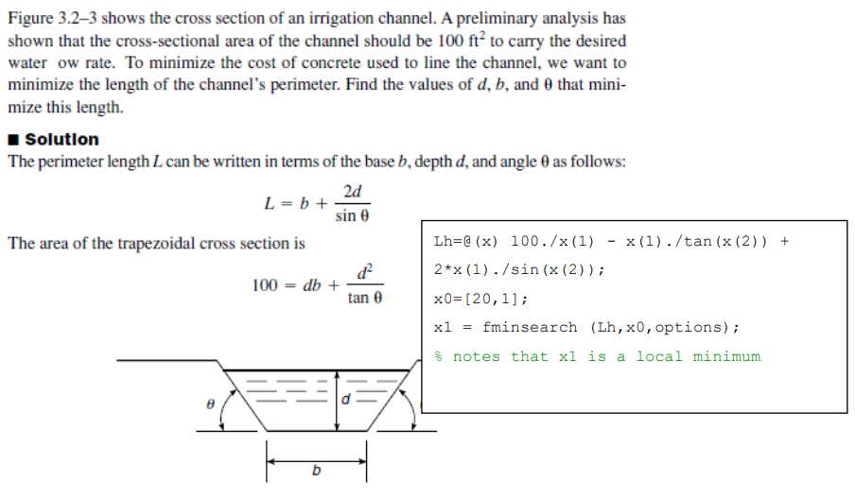
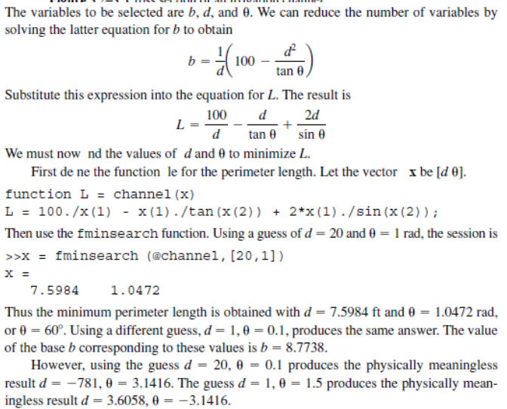
clear;clc;
options = optimset('PlotFcns',@optimplotfval);
Lh=@(x) 100./x(1) - x(1)./tan(x(2)) + 2*x(1)./sin(x(2));
x0=[20,1];
x1 = fminsearch (Lh,x0,options);

Slide 15
HOMEWORK

Slide 17
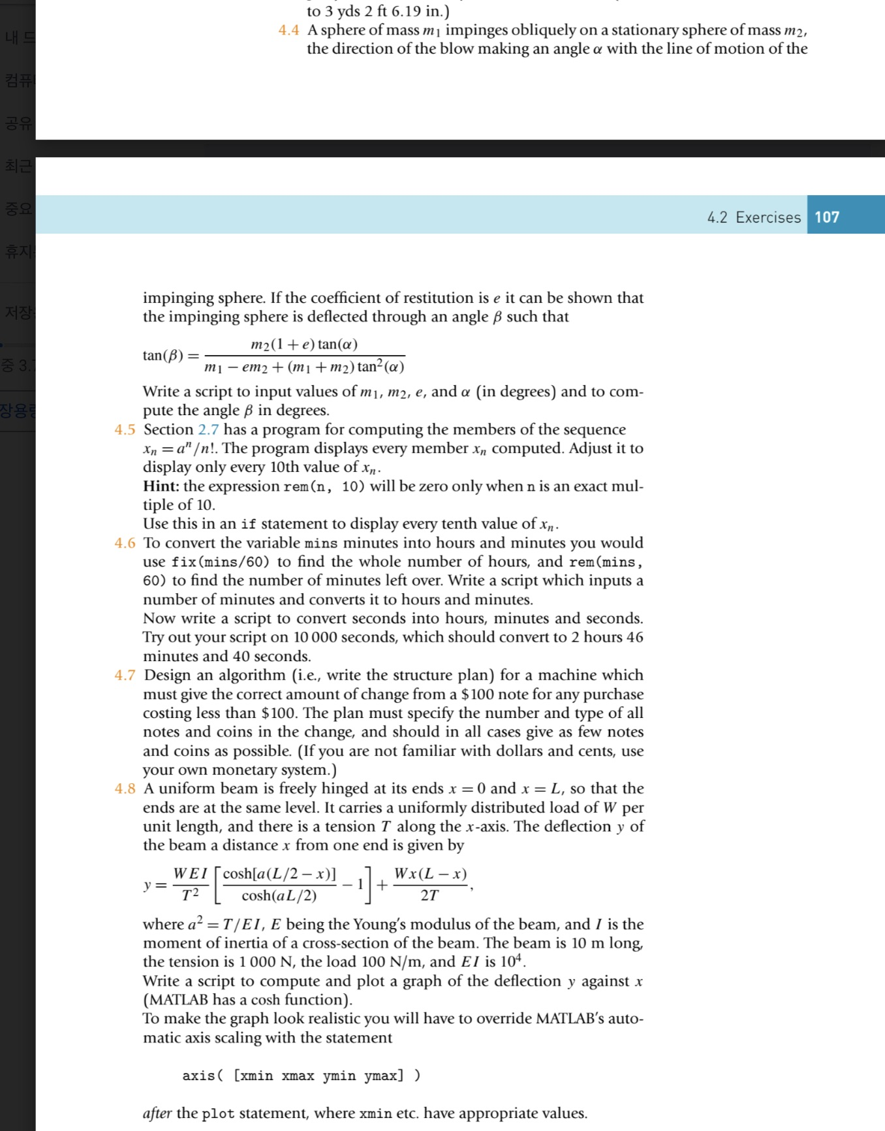

Slide 20
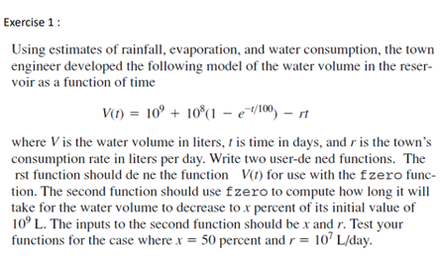
Ans :54 days

Slide 21
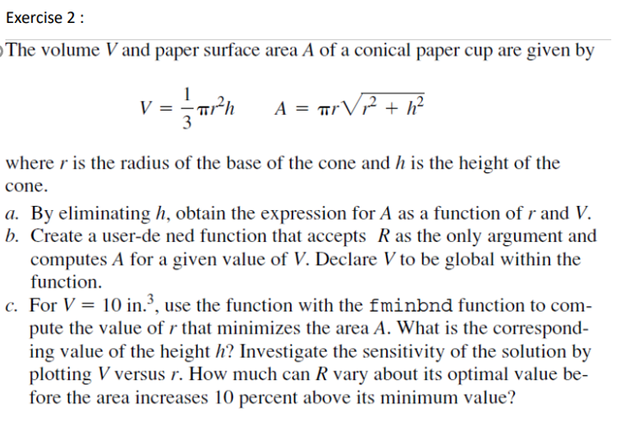
Ans:

